Slide 1
PERSONALIZED RENT PAYMENT FOLLOW UP SYSTEM REPORT.
Submitted in partial fulfilment of the requirements for the degree of
Bachelor of Science in Information science
By
ERASTUS MULA KIMATU – ISC/012/2016
Under the guidance of Dr. James Abila,
Department of Information Science and Informatics,
RONGO UNIVERSITY.
OCTOBER 2020

Slide 2
Background of the study.
Follow up is also monitoring which involves the collection and analysis of information about an activity, undertaken while the activity is ongoing. This can only be applied in rental houses during the rent payment process.
Globally, increased number of tenants makes management difficult especially for the landlords who are losing huge sum of money through tenants who evade rent paying the rent in time and end up escaping with part of the rent due to unavailability of the payment information.
Currently in Kenya, the landlord has to keep the records of payments in the books or files.
The above statement gives a clear declaration as to why a research on system development need to be done for the follow up on the operations done after rent collection are done currently.

Slide 3
Statement of the problem.
Follow up of payment records should be done through means which can easily get details of the rent payments done at whichever time.
Manual system used in recording of the customers’ payment data may end up getting lost or getting misplaced.
It is necessary to develop an automated system get the payments records of the tenant and store all the activities done.
Purpose.
This research aimed at investigating on how follow up of the payments can be efficient.
The aim was to research and come up with a system that will ensure easy follow up of payments records.

Slide 4
Specific Objectives
To study and analyze the requirement specifications of the rent records follow up system.
To save the time of landlords in following up payment records.
To design a convenient and flexible system.
To implement, test and validate the system.
Research questions.
What were the requirement specifications of the records follow up system?
How much time would the system save in following up the payment records?
How would the system be convenient?
How would the system be implemented, tested and validated?

Slide 5
Delimitation.
This study only targeted the landlords and tenants who were within the Rongo community. Initially this study confined itself to questionnaires.
Limitation of the Study.
Inadequate resources to study whole region and harsh weather conditions.
Inadequate financial resources and language barrier.
Significance.
This research work will enhance the efficiency and effectiveness of follow up of the payments done by the tenants.
This will improve the system and make it more technologically convenient for the landlords enabling them to follow up rent payment easily.

Slide 6
Chapter 2:Research gap.
The current system was faced with many limitations like prone to errors, duplication of data, time consuming and above all insecurity.
Conceptual framework.
Follow up system.
System requirements.
Testing.
Implementation.
Rent payment Records.
Date of payment.
Name of the tenant.
Amount paid.
Balance

Slide 7
Study population.
The Rongo community had a population of about five thousand people in total. The study population was only the tenants and landlords living in the rooms who are about three thousand in number.
The study population was characterized by the type of rental houses they lived in and gender.
Research instrument and data collection procedure.
Observation.
I observed tenants, caretakers and landlords as they carried out activities in the following up payments.

Slide 8
Interview.
Landlords of different rental houses were randomly selected and interviewed .
Questionnaires.
Questionnaires were used because they were considered economical and easy to formulate and analyse.
Sampling.
A Random sampling was used to choose tenants and landlords so as to provide an unbiased selection method.
Sample size.
In my side there was two sample sizes which were the landlords and above all the tenants.

Slide 9
Chapter 4; Data analysis, presentation and interpretation The data was analyzed with the aid of a computer using Statistical Package for Social sciences version 20 as a tool for analysis.
Respondents return rate on the questionnaires.
The total number of questionnaires disbursed were 50 and 40 (80%) were returned. This rate of return was considered adequate according to (Dilliman 2000).
Category | Instruments distributed | Instruments collected | Percentage %
Respondents | 50 | 41 | 82%
Total | 50 | 41 | 100%

Slide 10
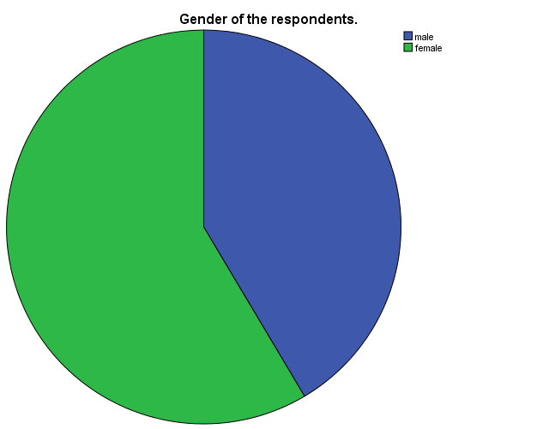
Gender.
Gender distribution of respondents.
Gender of the respondents.
 |  | Frequency | Percent | Valid Percent | Cumulative Percent
Valid | male | 17 | 41.5 | 41.5 | 41.5
 | female | 24 | 58.5 | 58.5 | 100.0
 | Total | 41 | 100.0 | 100.0
The findings showed that (41.5%) were male while (58.5%) were female.

Slide 11
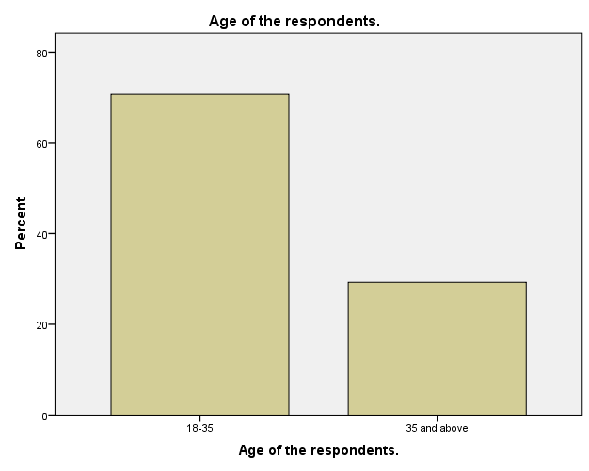
Age of respondents.
Age of the respondents.
 |  | Frequency | Percent | Valid Percent | Cumulative Percent
Valid | 18-35 | 29 | 70.7 | 70.7 | 70.7
 | 35 and above | 12 | 29.3 | 29.3 | 100.0
 | Total | 41 | 100.0 | 100.0
The findings showed that most percentage of the respondents were aged 18 to 35 with 70.7% and the others above 35 years had 29.3%.

Slide 12
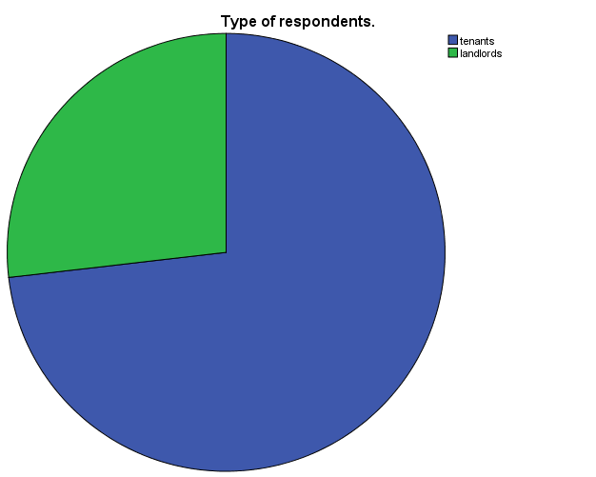
Type of respondents.
Type of respondents.
 |  | Frequency | Percent | Valid Percent | Cumulative Percent
Valid | tenants | 30 | 73.2 | 73.2 | 73.2
 | landlords | 11 | 26.8 | 26.8 | 100.0
 | Total | 41 | 100.0 | 100.0
The findings showed that most percentage of the respondents were tenants with 73% and the others landlords had 27%.

Slide 13
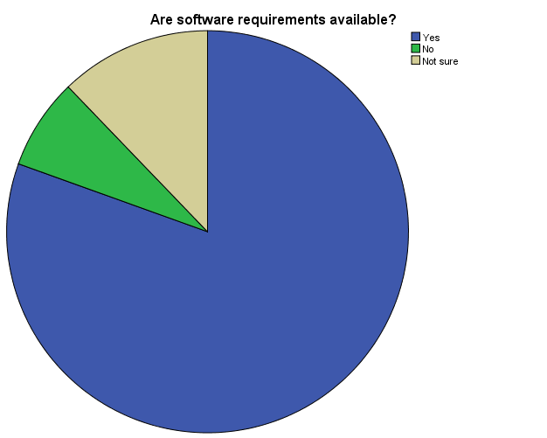
Response on software requirements to develop the proposed system
Are software requirements available?
 |  | Frequency | Percent | Valid Percent | Cumulative Percent
Valid | Yes | 33 | 80.5 | 80.5 | 80.5
 | No | 3 | 7.3 | 7.3 | 87.8
 | Not sure | 5 | 12.2 | 12.2 | 100.0
 | Total | 41 | 100.0 | 100.0
Large proportion of respondent 80.5% say that the software required to develop the proposed system may be available 7.4% of them say no while 12.1% are not sure. This indicates that it’s possible to develop the proposed system in Rongo Sub County.

Slide 14
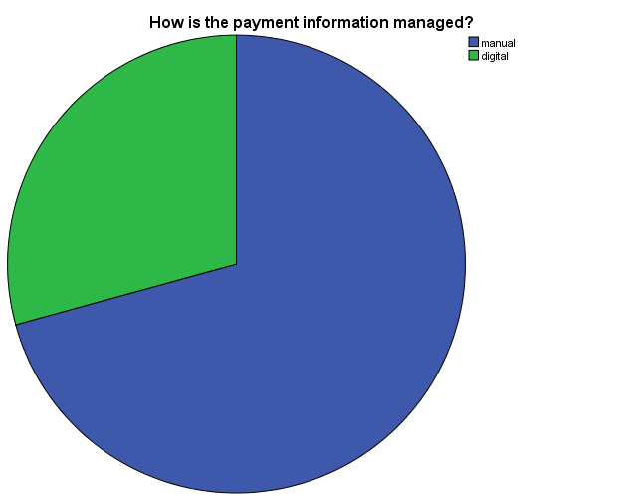
Response on how the payment information is followed.
Follow up in rent payment.
 |  | Frequency | Percent | Valid Percent | Cumulative Percent
Valid | Manual | 29 | 70.7 | 70.7 | 70.7
 | Digital | 12 | 29.3 | 29.3 | 100.0
 | Total | 41 | 100.0 | 100.0
Large proportion of respondent 70.7 % say that payment information is followed through the manual means while 29.3 % say through digital means .This indicates that there is need to develop the proposed system in order to make it easy for the landlords to follow up information.

Slide 15
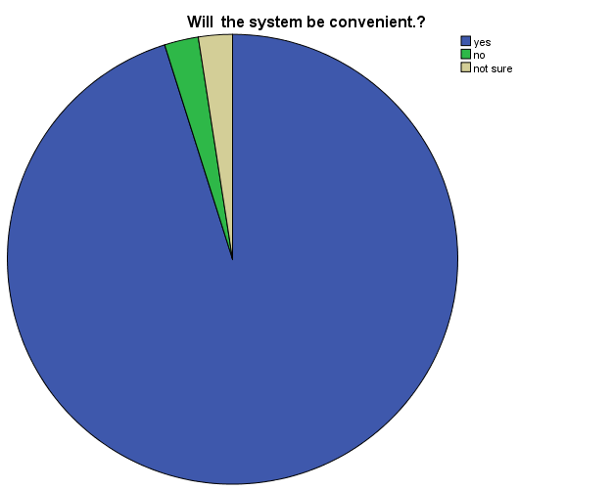
Response on whether the system will be convenient.
Will it be convenient for rent payment follow up?
 |  | Frequency | Percent | Valid Percent | Cumulative Percent
Valid | yes | 39 | 95.1 | 95.1 | 95.1
 | no | 1 | 2.4 | 2.4 | 97.6
 | not sure | 1 | 2.4 | 2.4 | 100.0
 | Total | 41 | 100.0 | 100.0
large proportion of respondent 94 % say that the system will be convenient 2% say no while 2 % say they are not sure .This indicates that the system will be convenient to most users.

Slide 16
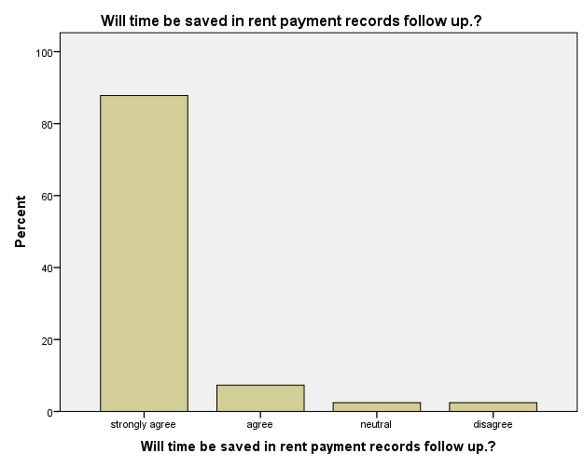
Response on time will be saved in following up payment records.
Response | respondents | Percentage
Strongly Agree | 36 | 88%
Agree | 3 | 8%
Neutral | 1 | 2%
Disagree | 1 | 2%
Total | 41 | 100%
88% of the population strongly agreed that time would be saved in following up the payments and 8% agreed.
this showed that the software would really help in following up of the payments.

Slide 17
CHAPTER 5
5.1 SYSTEM DESIGN
Before developing a system we have to design our system like how Use case of our System. Data Flow Diagram (DFD) provides a view of how the system or business flows that able to increase the efficiency and effectiveness to achieve system objectives. For native user we have Use Case Diagram thus they could easily understand about our system. Entity Relationship Diagram (ERD) will tell us about our database.
UML Design:
The Unified Modeling Language is a general-purpose, modeling
Language in the field of software engineering used to provide a standard way to visualize the design of a system.
Use Case: These are used to describe the functionality of a system in a horizontal
way.

Slide 18
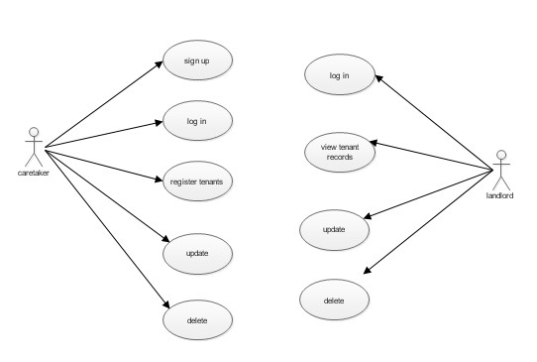
Use Case Diagram
Application design and data flow diagram
Caretaker Registration
Landlord authentication
Caretaker Login
View the tenant records
R.P.F.S
APP
Register tenants
View the database
Update the database
Update the record
Delete the database
Delete the record

Slide 19
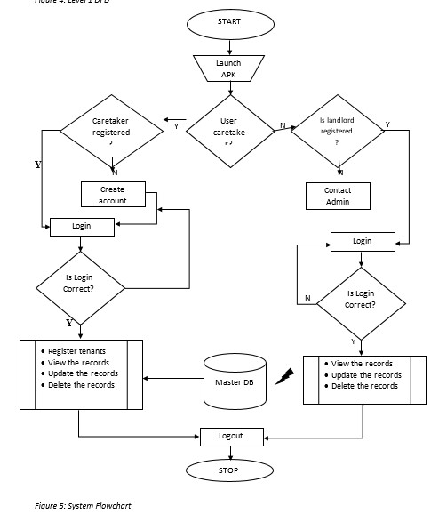
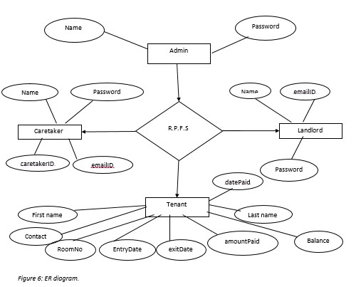

Slide 20
IMPLEMENTATION:
Implementation is when the theoretical design is turned out into a working system. Thus it is considered to be the most critical stage in achieving a successful new system and in giving the user, confidence that the new system will work and be effective.
2 DEVELOPMENT ENVIRONMENT
The system platform used is android studio version 3.6. The programming language used is java and xml.
IMPLEMENTATION ARCHTECTURE
XML
Java
Firebase
FrontEnd
BackEnd

Slide 21
SYSTEM TESTING
Testing is done to discover errors. It provides a way to check the functionality of components.
System Test:
System testing ensures that the entire integrated software system meets requirements. It tests a configuration to ensure known and predictable results.
Acceptance Testing:
User Acceptance Testing requires significant participation by the end user. It ensures the system meets the functional requirements.
Test Results:
All the test cases mentioned passed successfully. No defects encountered.
USER MANUAL
The program may be maintained on the ground that the system requires an upgrade. When there is a new field to be added in order to serve users well. Though it is compiled as standalone software the database can be tempered with but it’s advisable that the admin put a password on the file to secure the database from intrusion.
THE FOLLOWING PRECAUTION SHOULD BE DONE
Backup database frequently and use strong passwords.

Slide 22
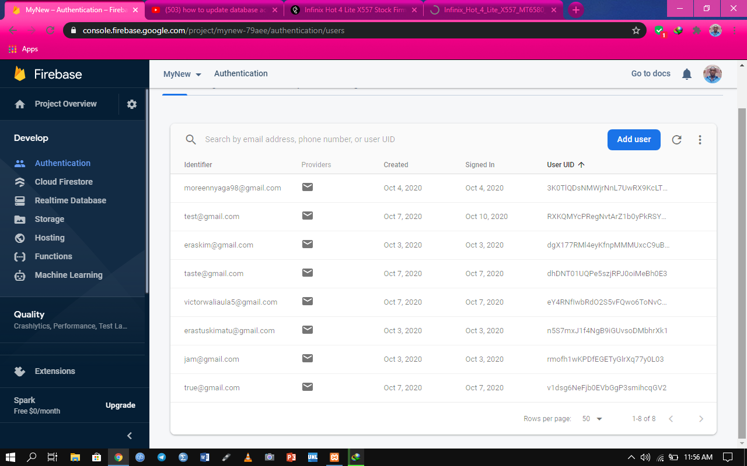
System demo
New users sign up in the firebase

Slide 23
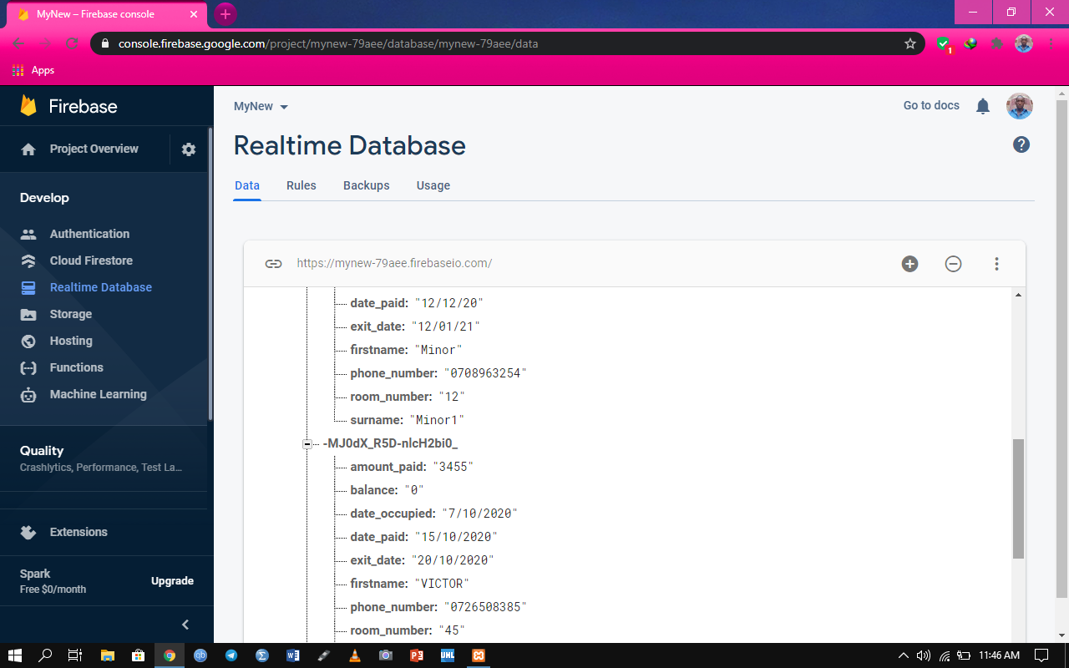
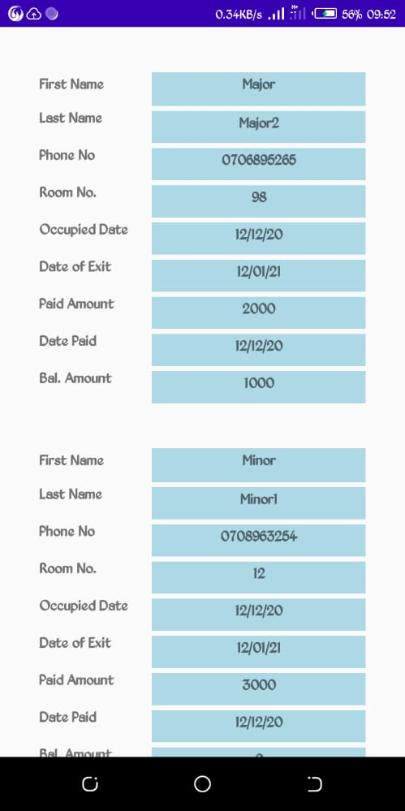
Database in the firebase
Database view by landlord

Slide 24
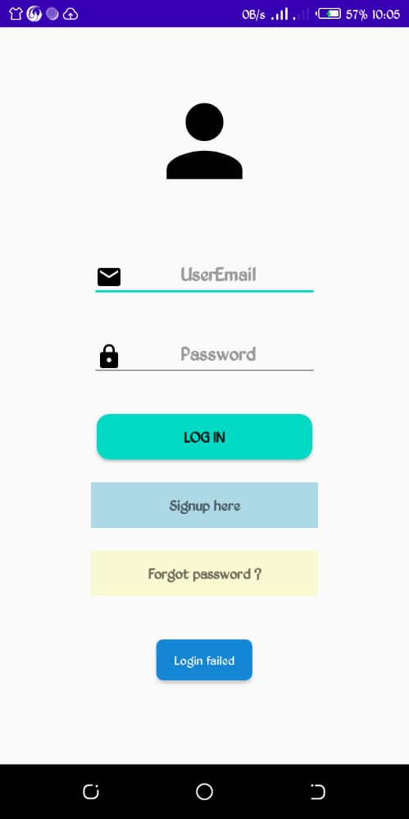
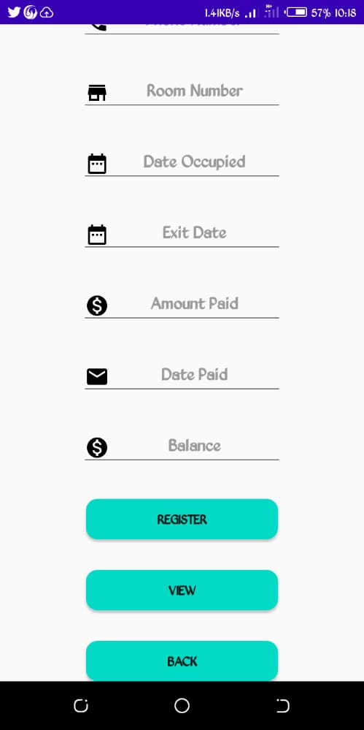
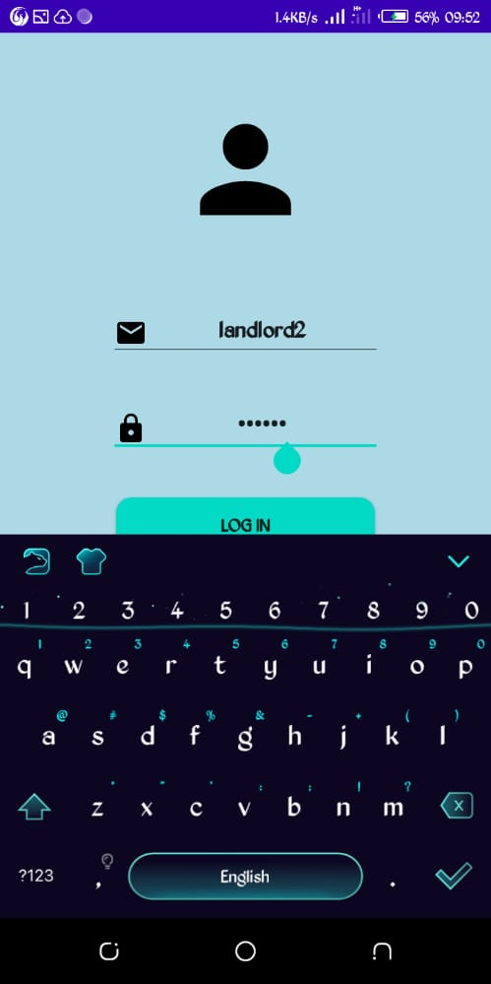
Caretaker login page
Tenant registration page
Landlordlogin page

Slide 25
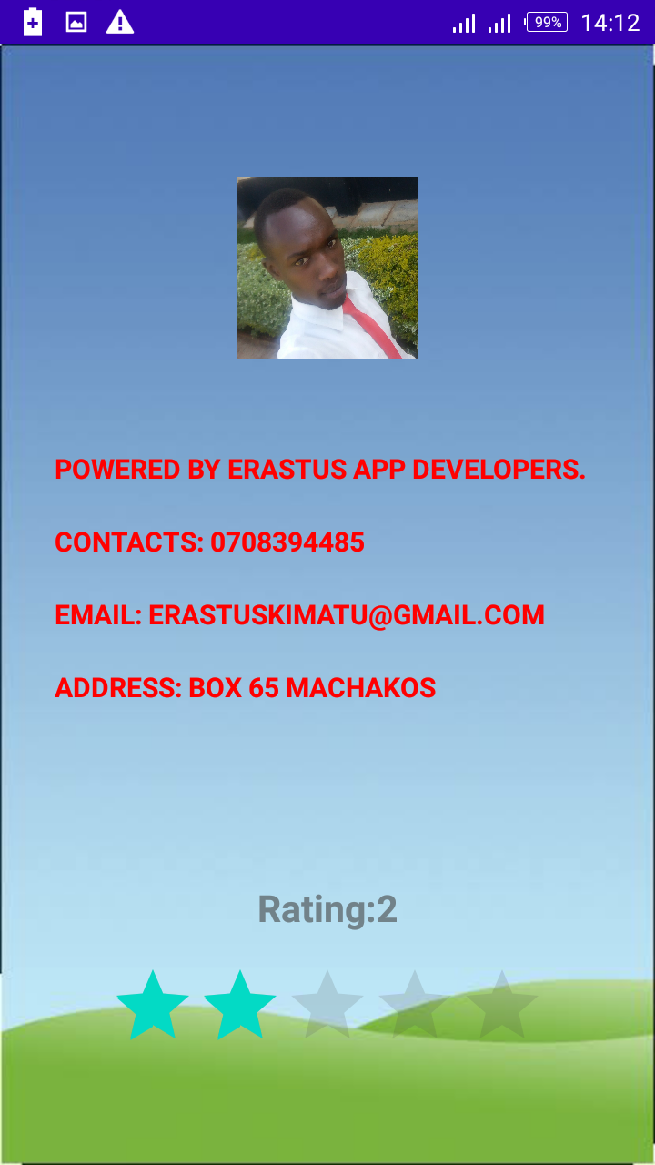
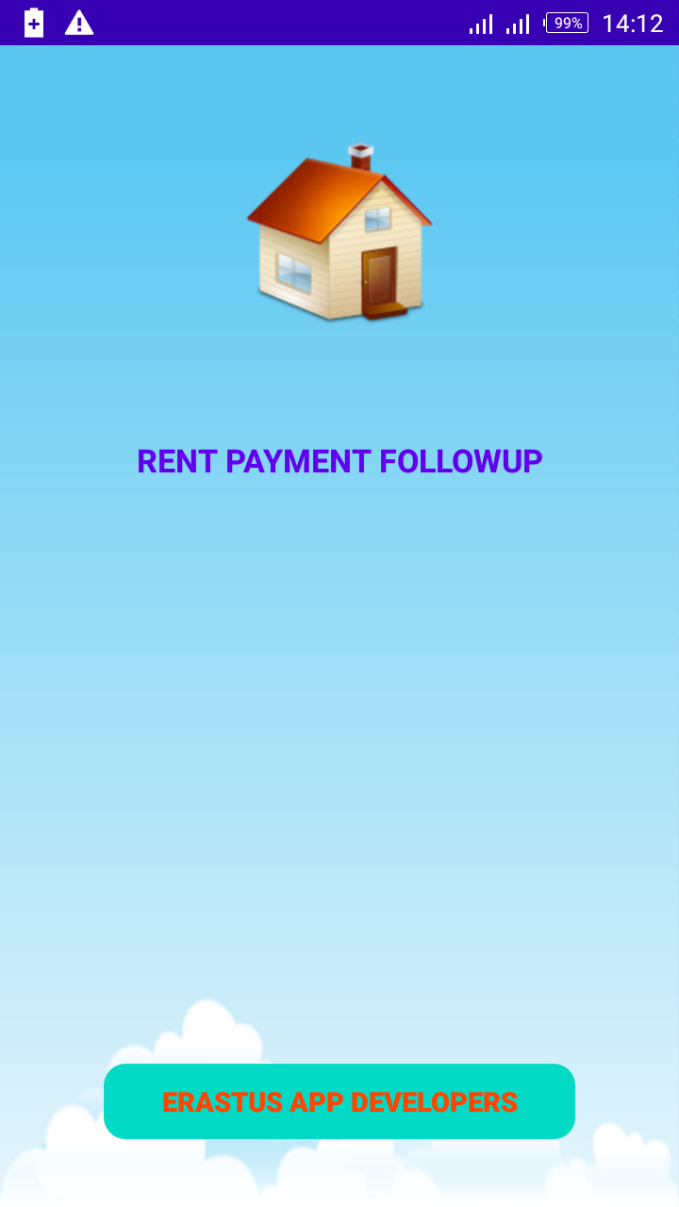
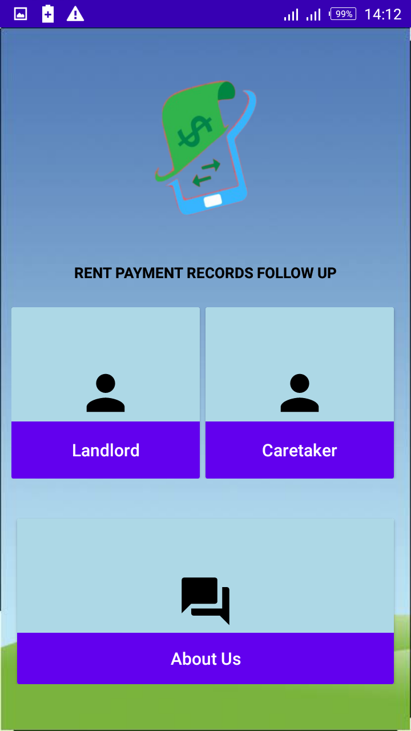
About us page
Landing page
Dashboard page

Slide 26
SUMMARRY, RECOMMENDATION, CONCLUSION AND THE PROBLEMS ENCOUNTERED
SUMMARY
This project is a follow up design system for the tenants’ payments where one can register as a caretaker, register the tenant, update details and delete the record also. The admin who is the landlord can be able to login, view the records as entered by the caretaker. He or she can also update or delete the tenants’ records.
CONCLUSION
I think this system will help them monitor and follow all the activities to help provide timely follow up for those not paying in time.
RECOMMENDATION
I recommend that if there is going to be any modification to the system it should endeavor to improve on the limitations such as inclusion of the tenants module and further increase the system architecture and ensure that the tenants can get access to their own records independently but no update and delete privileges allowed.

Slide 27
PROBLEM ENCOUNTERED
The following are some of the problems or challenges encountered.
Insufficient time on research to get more information from users and add functionality to more system.
Insufficient funds to get advanced features and hardware for developing features.
Computer failure issues

